Slide 1

Xtra Dimension
CORPORATE PRESENTATION

Slide 2

Xtra Dimension was established in 1992 by ronen ben ari which is the owner.

Slide 3
The Company’s offices located in Nes Ziona city and production halls are situated in the Barkan Industrial Zone in Israel.
Our sales and marketing is managed by Vered Aharon.

Slide 4
Our Vision
The vision of Xtra Dimension as a company specializing in this field, is to keep manufacture of only top quality products in a very competitive price and very short time of delivery. Also to develop new products in the field.
The quality of our products is reflected in the overall quality both at product level and that of the service accompanying the product over the long term.

Slide 5
Our factory is on 1000 sqm and 20 workers on producing.
Our Experience
We are leading the area of manufacture inflatable in Israel for over 20 years.

Slide 6
Our inflatable's are planned, designed, produced and stored by us in Israel.
Extra Dimension keeps up to date with the pace of technological changes, and invests in research and development in the field in order to improve the overall quality of the inflatable's produced for our customers.

Slide 7
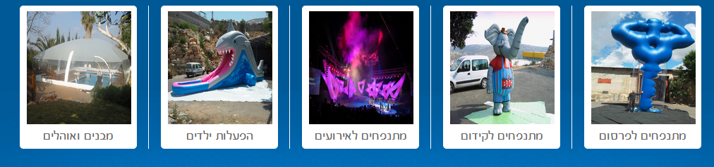
Xtra Dimension has extensive experience in the field including working with overseas entities.
Extra Dimension offers the entire variety of inflatable's under one roof, in all sizes, shapes and technologies relevant to the field.

Slide 8
Our Satisfied Customers list local and international both, is our pride and also our best quality reference

Slide 9

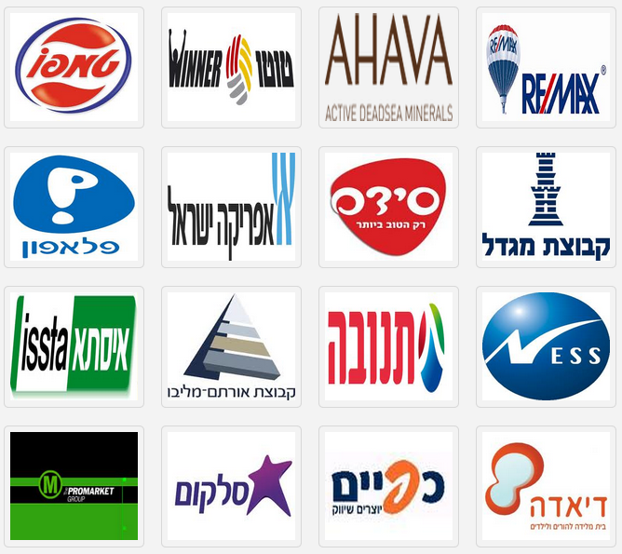

Slide 10



Slide 11



Slide 12
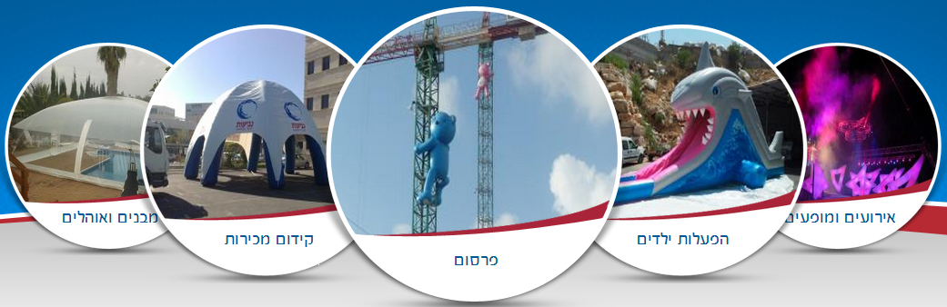
Our products come in various types, for any kind of use or type of event:

Slide 13
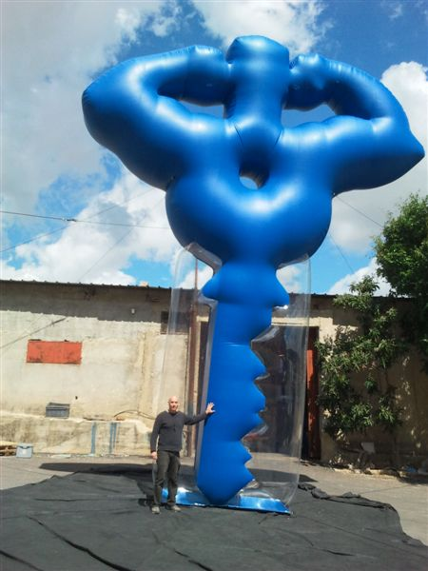
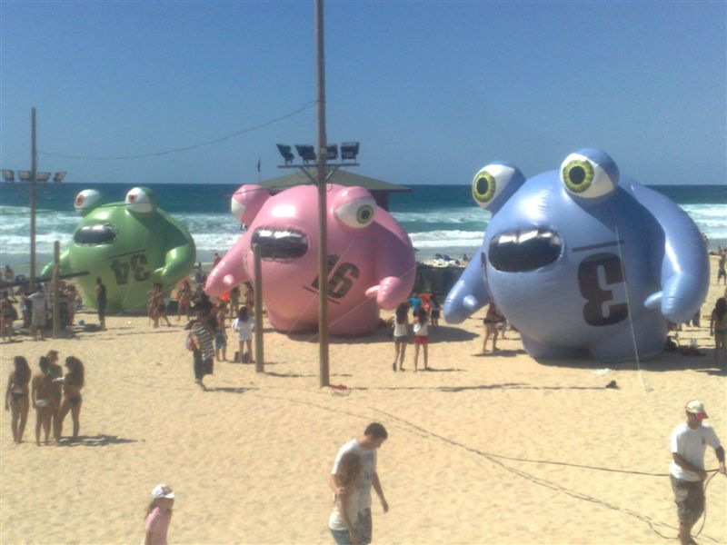
Giant inflatable - for advertising and point of sale

Slide 14
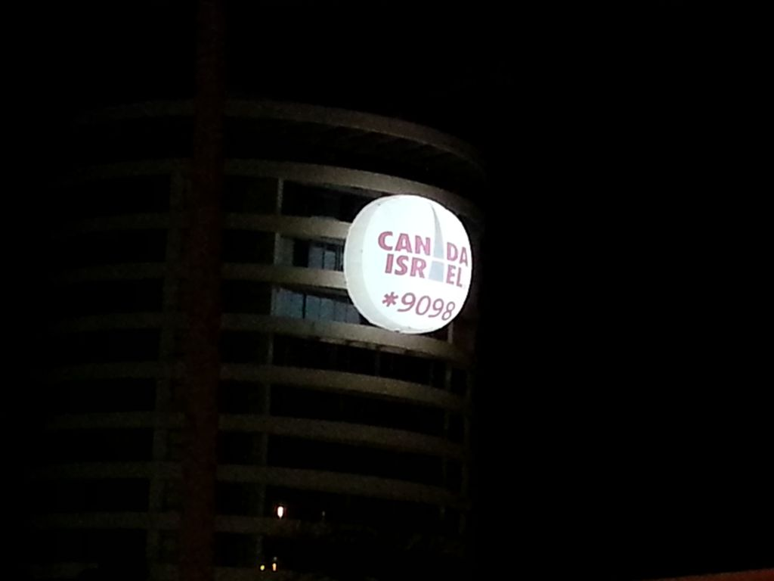
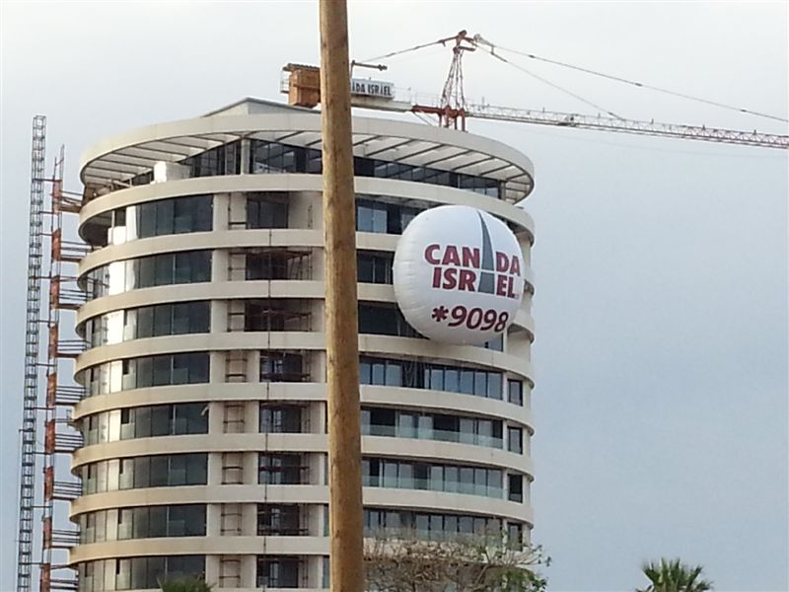
Advertising on building with internal light

Slide 15
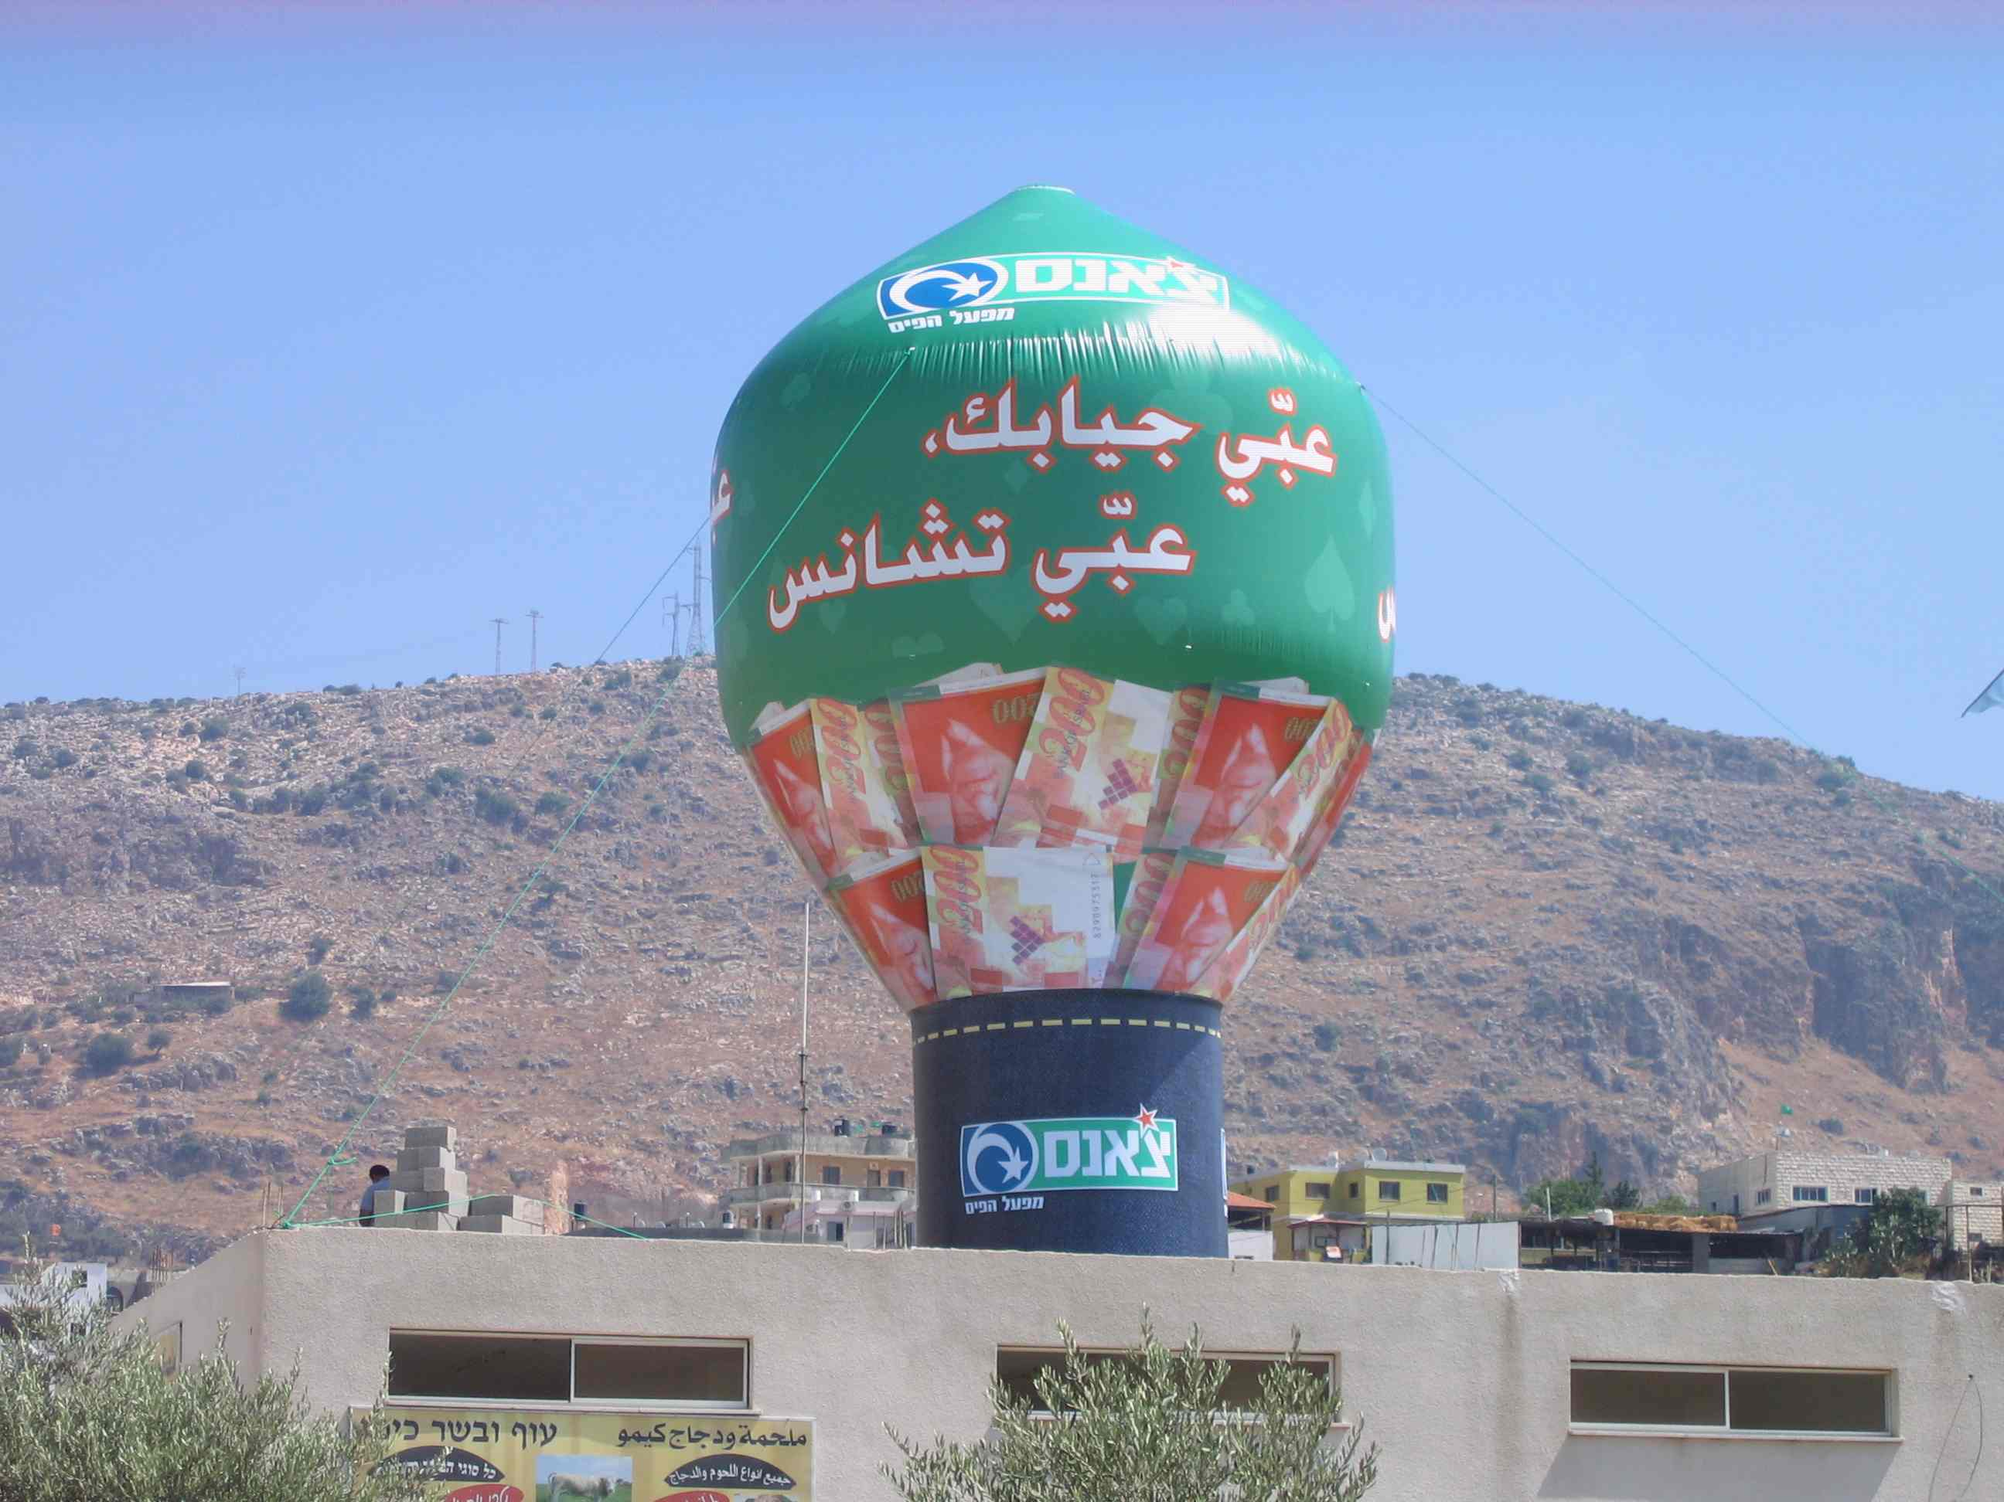
Hot air balloon shape

Slide 16
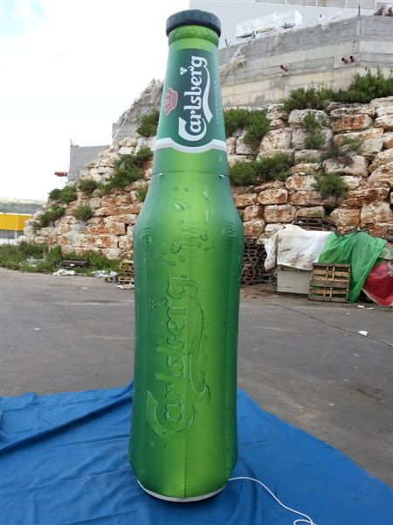
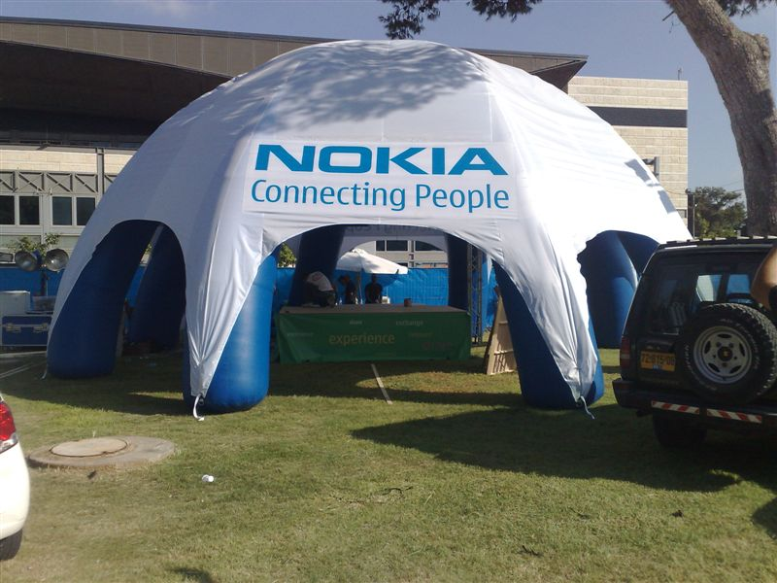
Sales promotion

Slide 17
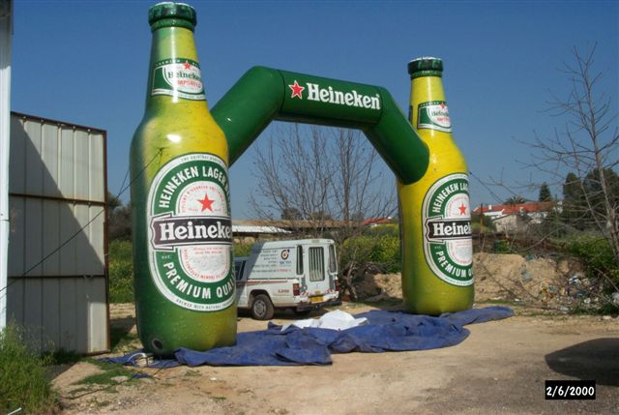
Custom arches

Slide 18
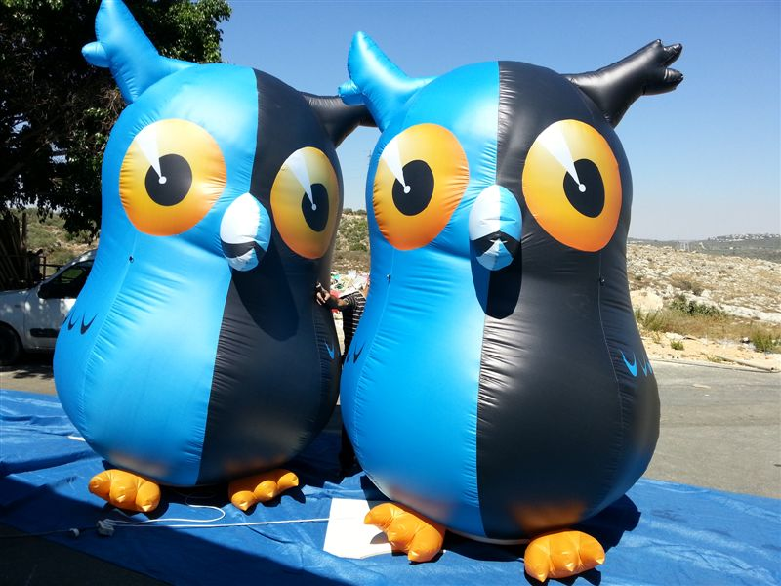
Costume replica

Slide 19
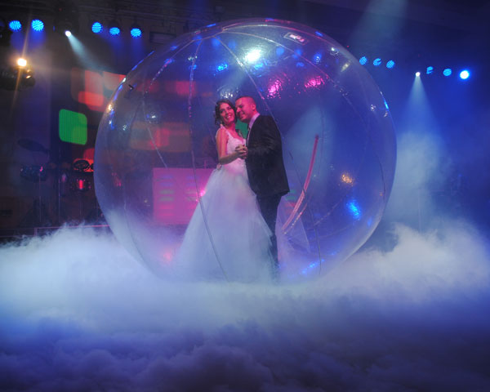
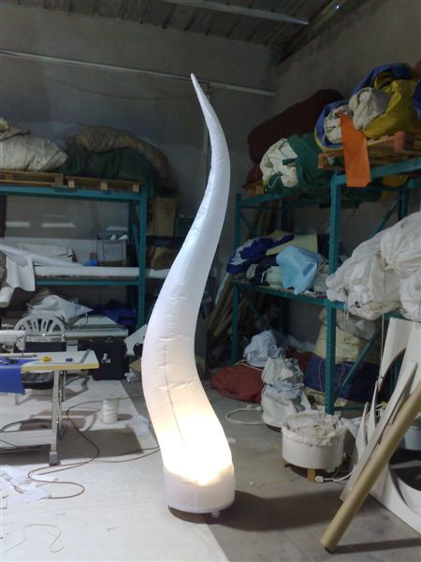
Inflatable for events and shows

Slide 20
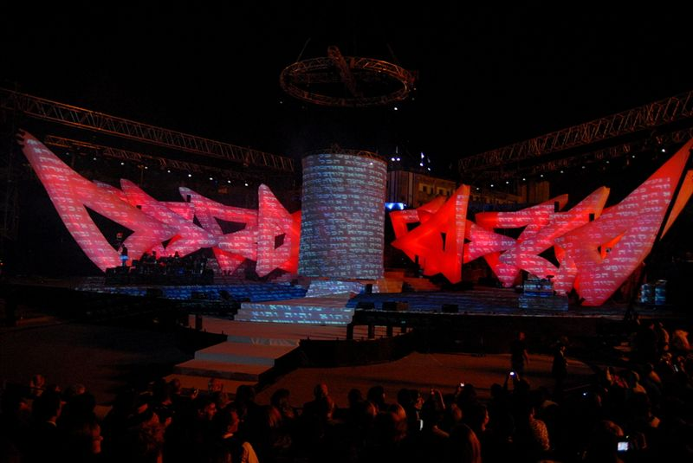
Inflatable for stage decorations

Slide 21
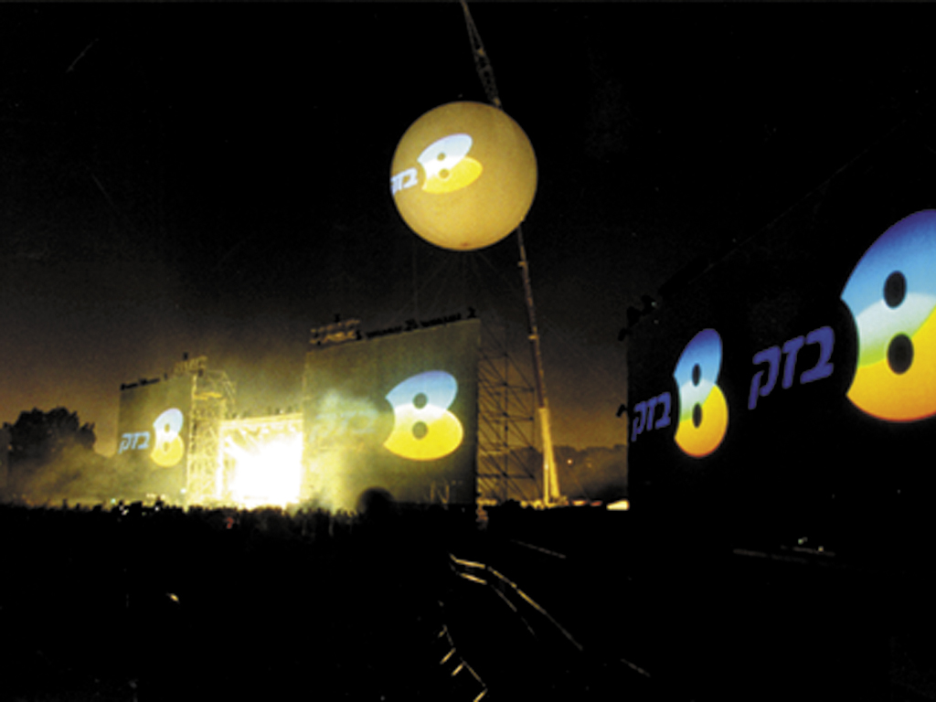
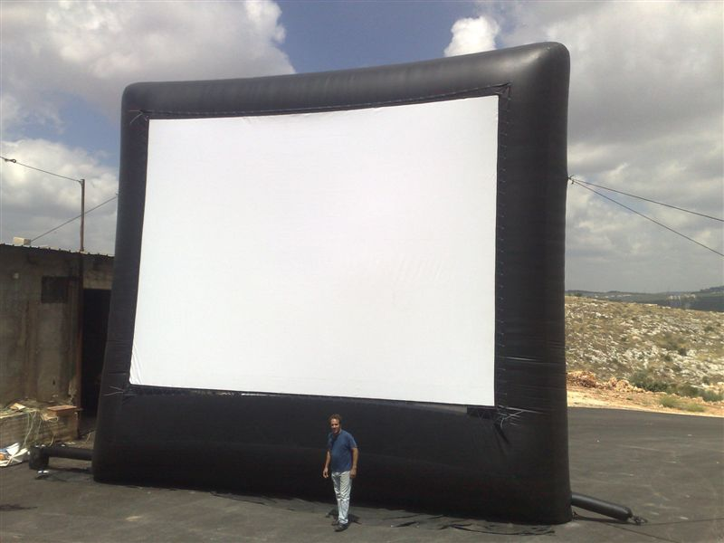
Inflatable’s for video screening

Slide 22
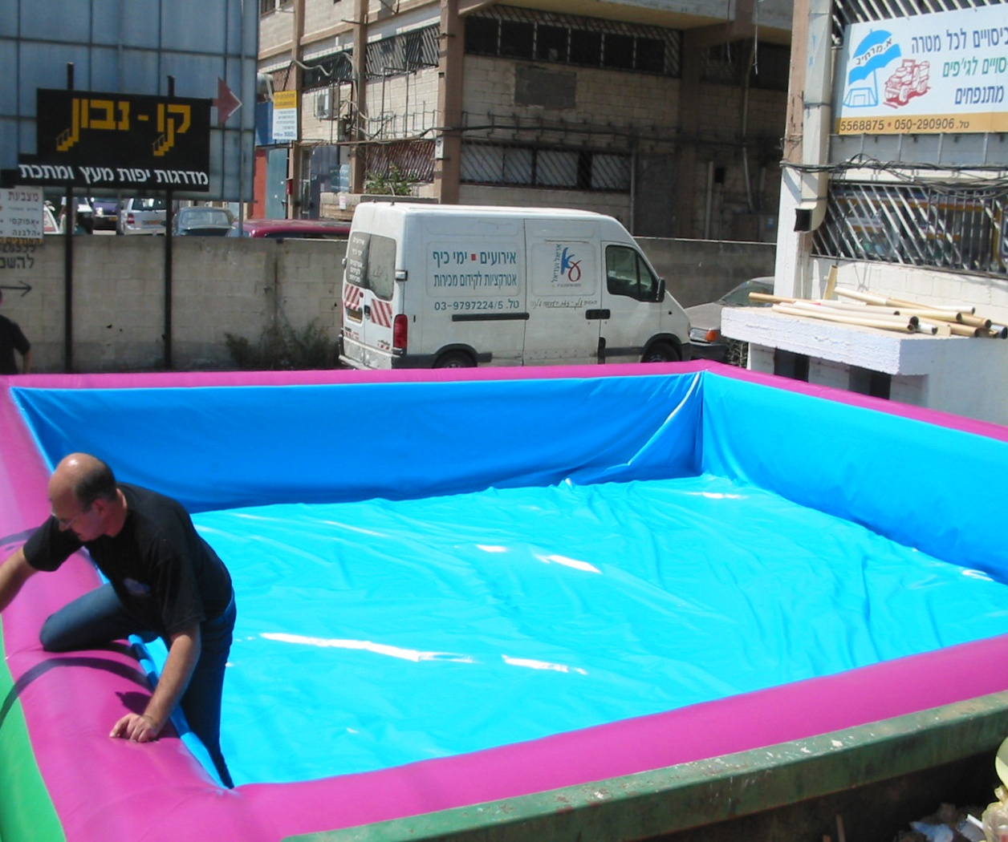
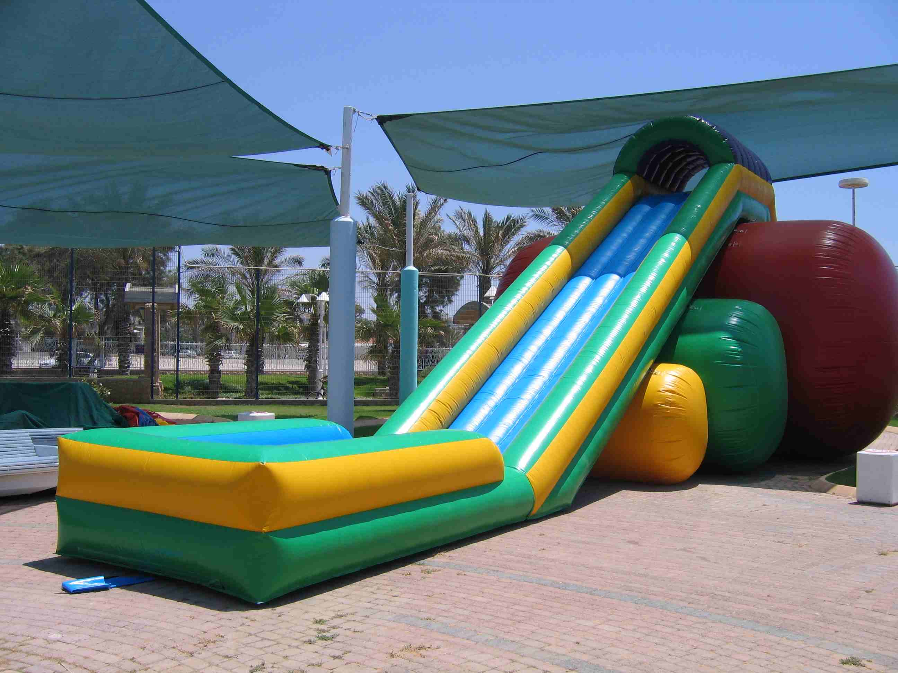
Inflatable for recreation & fun for kids and adults

Slide 23
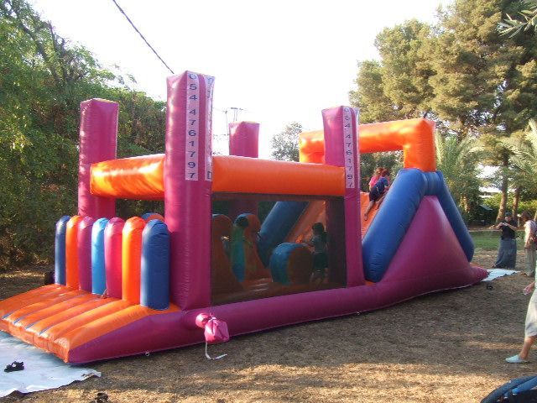
Inflatable for recreation & fun for kids and adults

Slide 24
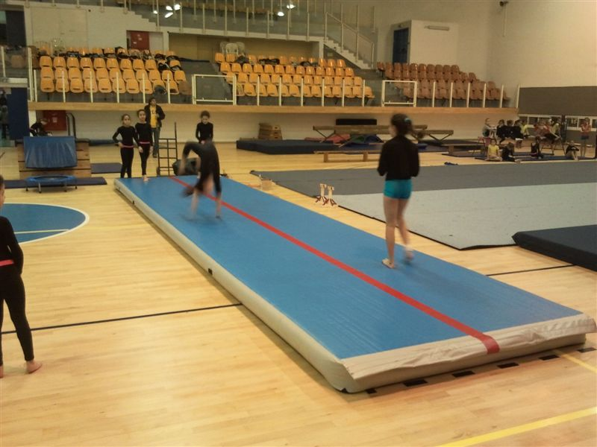
Inflatable gym mat – airfloor

Slide 25
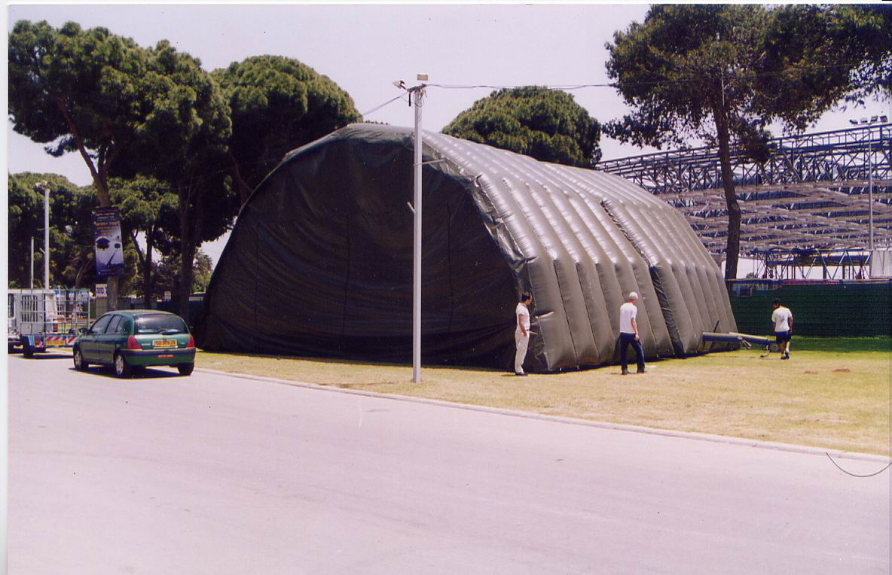
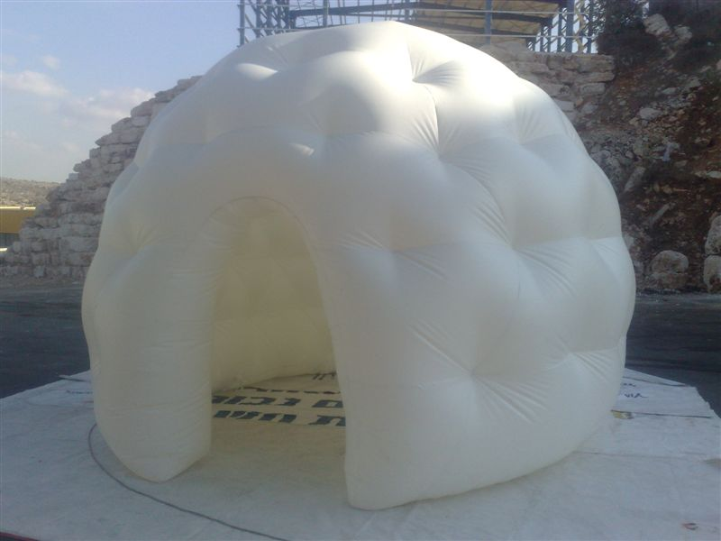
Inflatable tents

Slide 26
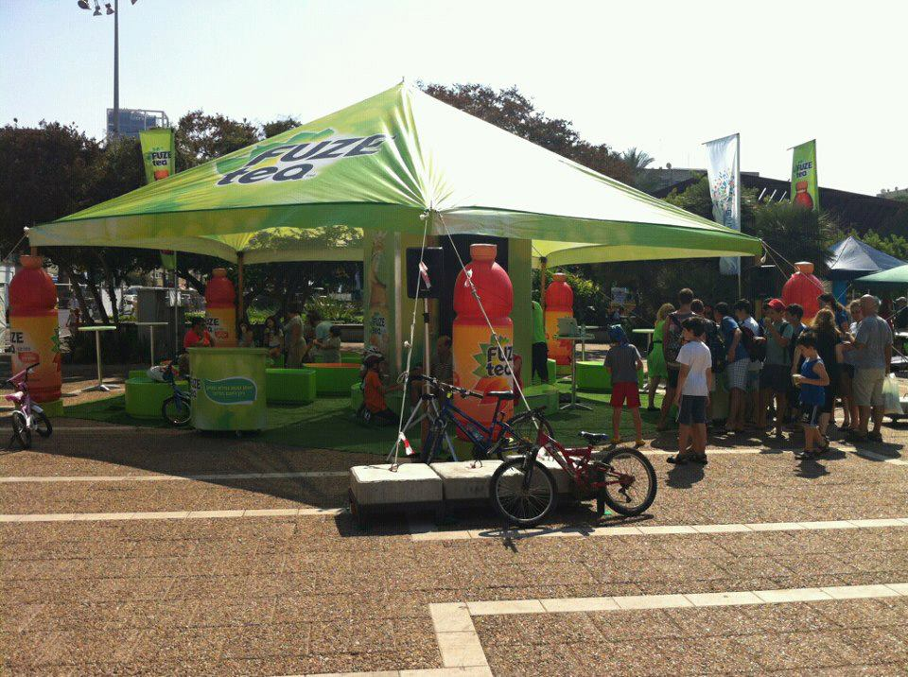
Non inflatable tents

Slide 27
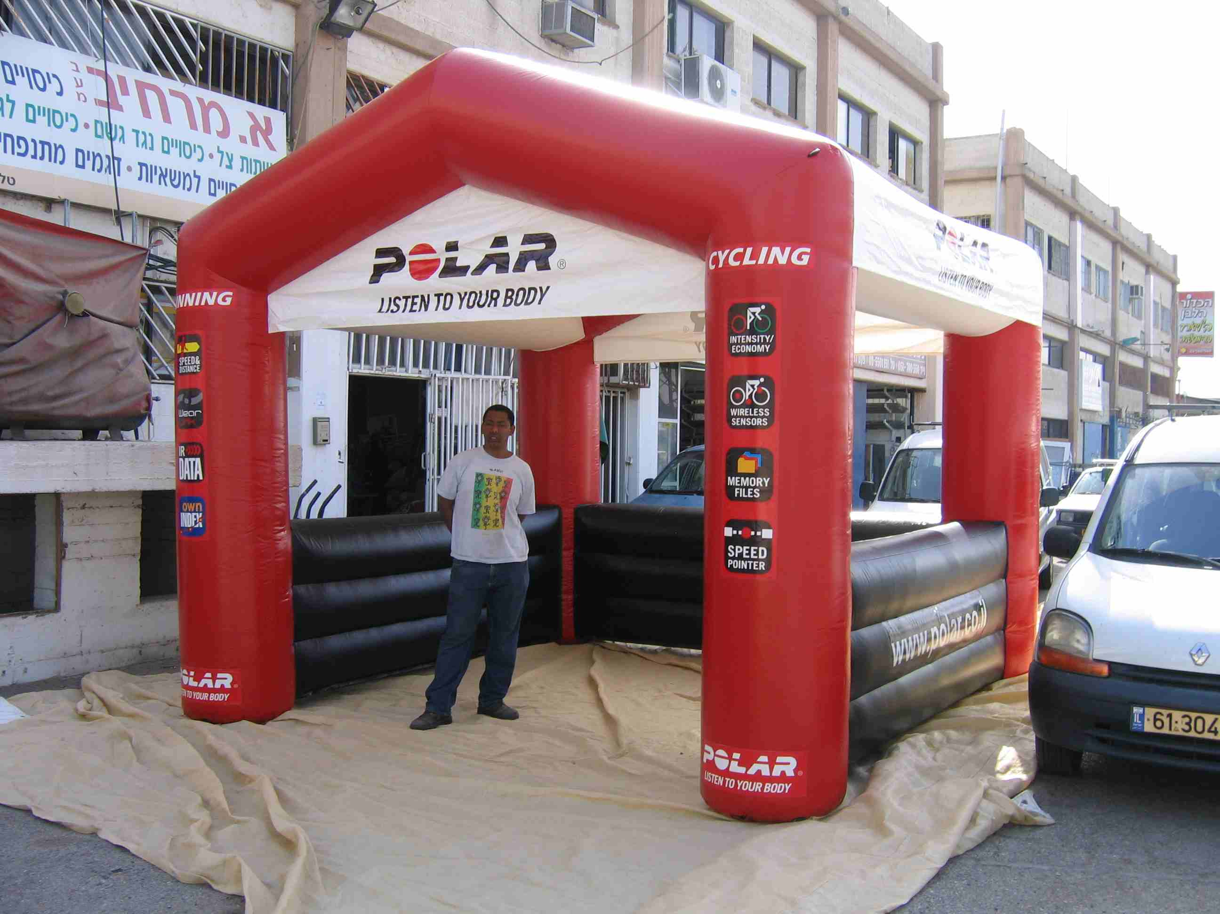
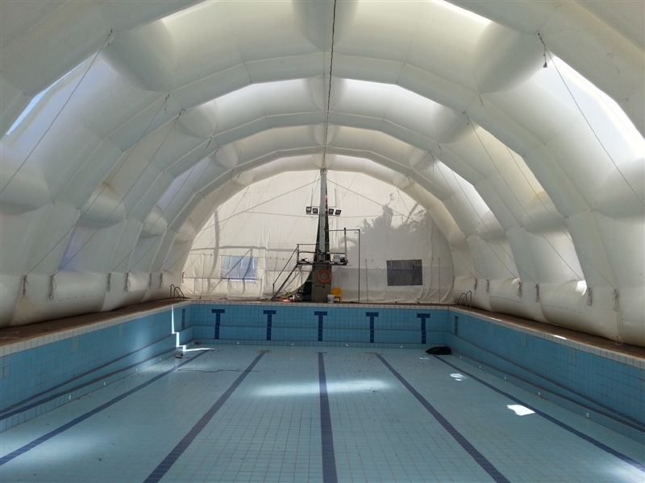
Inflatable covers

Slide 28
Thank you

